Slide 1
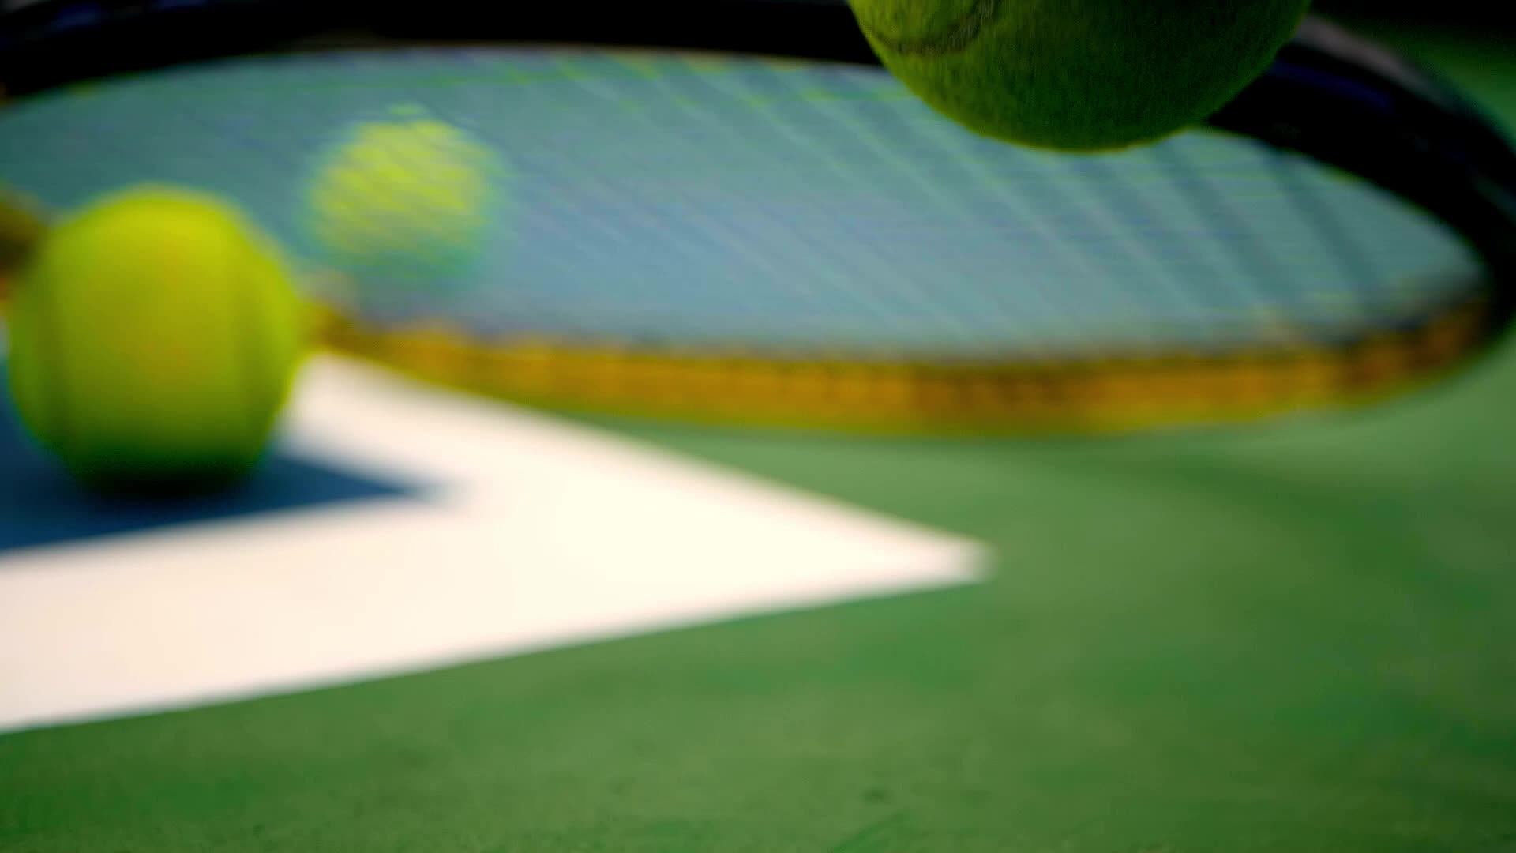
The Optimal Tennis Serve by David Seppala-Holtzman St. Joseph’s University

Slide 2
Consider the Tennis Serve
The server has two decisions to make
In what direction should she aim the ball?
With how much force should she hit it?

Slide 3
The Long and the Short Serves
In a given direction, the server can use the minimal amount of force that just gets the ball over the net
We shall call this the short serve
Alternatively, she can exert the maximal amount of force that places the ball at the far end of the service box, just within bounds
We shall call this the long serve

Slide 4
The Optimal Serve
We seek the direction in which the distance between the points of landfall for the ball in the long and short cases is maximal
This will the most forgiving direction for the server as the difference between the minimal and maximal amounts of force is the greatest
We shall call this direction the optimal serve

Slide 5
The Court Dimensions
A regulation singles court is 78 feet long and 27 feet wide. The net straddles the width of the court at its midpoint and is 3 feet high.
In the next slide, we depict the court and our chosen coordinate system
The server with her arm raised over her head, holding the racquet, is rendered as a red vertical line
The point where the ball meets the racquet is H feet above the ground
The service box is outlined in blue

Slide 6
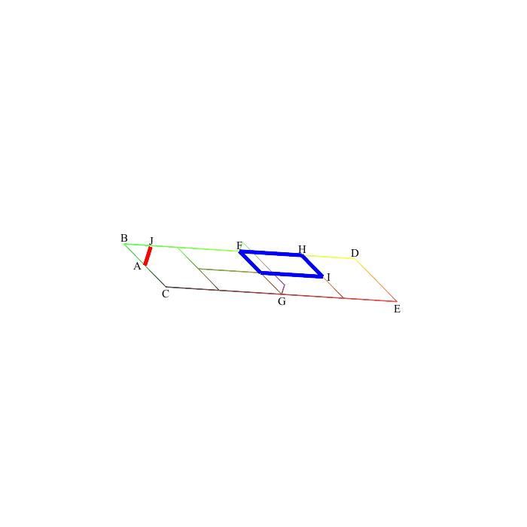
Our Coordinate System
Here are the coordinates of the labeled points:
A=(0,0,0) B=(0,13.5,0) C=(0,-13.5,0) D=(78,13.5,0) E=(78,-13.5,0) F=(39,13.5,0) G=(39,-13.5,0) H=(60,13.5,0) I=(60,0,0) J=(0,0,H)

Slide 7
Our Model
We are eliminating the opponent. We are focusing on the serve, alone
There is no friction. Consequently, the trajectory of the ball, which is acted upon solely by the initial impetus and gravity, will be a parabolic arc
The point of impact of the ball and the racquet will be the vertex of this parabola
The ball is a zero-dimensional point
The boundary lines are one-dimensional with no thickness
This last assumption makes the ball hitting a line and being within bounds a distinction without a difference
Likewise, the requirement that the server’s feet be just behind the baseline and slightly to one side of the midpoint is rendered moot by this assumption. Hence, we place the server’s feet at the origin, point “A” in the previous slide

Slide 8
Distance Between Landfall of the Long and Short Serves
In the following slide, we depict the long and short serves
We mark the points of landfall of each
The distance between these point is rendered by the green line

Slide 9
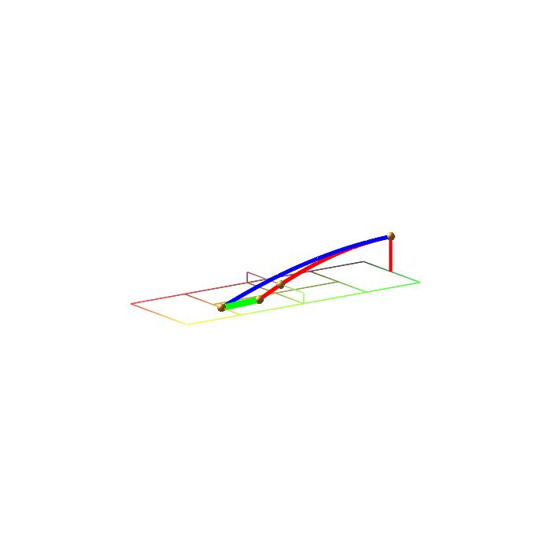
Landfall for the Long and Short Serves

Slide 10
The Short Serve Part I
The server rotates her body through angle t in the anti-clockwise direction with
0 < t < arctan(13.5/60)
This places the ball’s trajectory in the plane, P(t), that is orthogonal to the xy-plane and makes an angle of t with the xz-plane.
The distance between her feet and the base of the net is 39/cos(t) in P(t)
Now imagine a “phantom net” whose distance to the server’s feet is 39/cos(t) in the xz-plane
We shall compute the parabolic trajectory of the short serve in the xz-plane using the “phantom net”

Slide 11
The Short Serve Part II
The parabola will have equation z = ax² + bx + c in the xz-plane
It will pass through the points (0, H) and (39/cos(t), 3)
Ordinarily, one needs three points to determine the coefficients of a quadratic equation
As we have taken the point (0, H) to be the vertex of the parabola, these two points are sufficient
We derive the equation: z = [cos²(t)(3-H)/39²] x² + H
This is the equation for the serve in the xz-plane
We must translate this trajectory to the plane P(t)

Slide 12
The Short Serve Part III
In order to find the trajectory of the short serve in the plane P(t), we rotate the parabola we just derived in the previous slide about the z-axis (this is our server’s body)
This yields a paraboloid
Then we intersect this paraboloid with P(t)

Slide 13
The Short Serve Part IV
To generate our paraboloid, we take the equation: z = [cos²(t)(3-H)/39²] x² + H and solve for x in terms of z
This will serve as our radius function
We get:

Slide 14
The Short Serve Part IV
To generate our paraboloid, we take the equation: z = [cos²(t)(3-H)/39²] x² + H and solve for x in terms of z
Note that H >3 and H ≥ z so the term under the radical is non-negative
This will serve as our radius function
We get:

Slide 15
The Short Serve Part V
Using this radius function, we get a paraboloid with the equation:

Slide 16
The Short Serve Part VI
The plane P(t) has the following equation: $cos⁡(t+\frac{π}{2})$x + sin($t+\frac{π}{2}$)y=0
This simplifies to $−\sin\left(t\right)x+\cos\left(t\right)y=0$ or just $y=\tan\left(t\right)x$
Intersecting this with our paraboloid yields the space curve given by parametric equations:
$x=39\sqrt{(z−H)/(3−H)}$ $y=39 tan⁡(t)\sqrt{(z−H)/(3−H)}$ z = z

Slide 17
The Short Serve Part VII
Setting z = 0 in the equations for the trajectory we have just derived yields the coordinates of the point of landfall of the short serve in the chosen direction:
(39$\sqrt{−H/(3−H)}, 39\tan\left(t\right)\sqrt{−\frac{H}{3−H}}, 0)$
The distance between this point and our server’s feet is $\frac{39}{cos⁡(t)} \sqrt{H/(H−3)}$
In the next slide, we depict the paraboloid, the plane, P(t), and the trajectory of the ball
We have distorted the scale to improve clarity

Slide 18
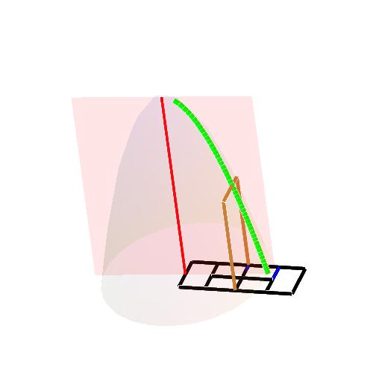
The Short Serve Part VII

Slide 19
The Long Serve
Finding the point of landfall for the long serve in direction t is trivial
It has coordinates (60, 60 tan(t), 0)

Slide 20
The Distance Between the Points of Landfall and the Optimal Serve
In a given direction, t, the distance between the points of landfall of the long serve and the short serve is:
$D= \frac{1}{cos⁡(t)}\left(60−39√\frac{H}{H−3}\right)$
This is clearly minimal when t = 0 and increases as t increases
As the largest value of t that still yields a legal serve is arctan(13.5/60), the server should rotate her body through this angle to achieve the most forgiving direction for her serve
This is the optimal serve that we set out to find.

Slide 21
The Optimal Serve
So, we see that the optimal serve is in the direction determined by the angle arctan(13.5/60)
This is approximately 12.68 degrees
Choosing this angle means that the server is aiming at the far outside corner of the service box
We depict the long and short serves in this direction in the next slide

Slide 22
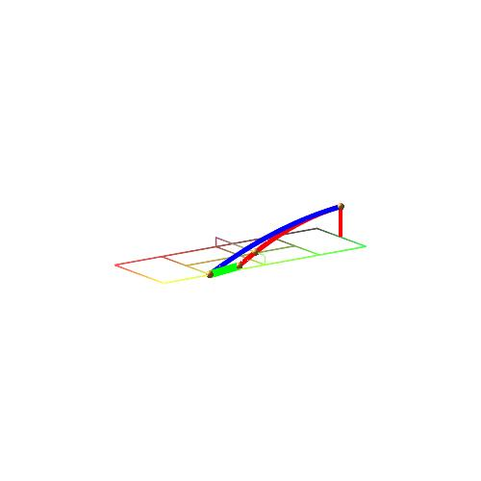

Slide 23
A Final Observation
For any given value of t, $D= \frac{1}{cos⁡(t)}\left(60−39√\frac{H}{H−3}\right)$ is an increasing function of H
Thus, the taller the player, the more forgiving the serve will be
Size matters!

Slide 24
Thank you!

