Slide 1
Mathematics: The Italian Connection
Prof. D.N. Seppala-Holtzman
St. Joseph’s College
faculty.sjcny.edu/~holtzman

Slide 2
Things Associated with Italy
When one thinks of Italy, many things come to mind
Italy, with its long, proud history, has produced many famous people

Slide 3
One Thinks of Explorers
Christopher Columbus
Marco Polo

Slide 4
One Thinks of Scientists
Galileo
Cassini
Fermi
Avogadro

Slide 5
One Thinks of Artists
Michelangelo
Titian
da Vinci
Botticelli
Caravaggio
Bellini

Slide 6
One Thinks of Film Directors
Fellini
Rossellini
Bertolucci
Antonioni
Zeffirelli
Pasolini

Slide 7
One Thinks of Composers
Vivaldi
Verdi
Rossini
Puccini

Slide 8
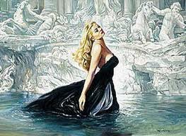
One Thinks of “La Dolce Vita”

Slide 9
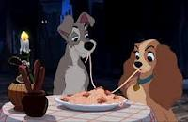
La Dolce Vita II

Slide 10
What about Mathematics?
Today, I wish to add Mathematics to the list
There are many great Italian mathematicians
I would like to put the spotlight on a number of them

Slide 11
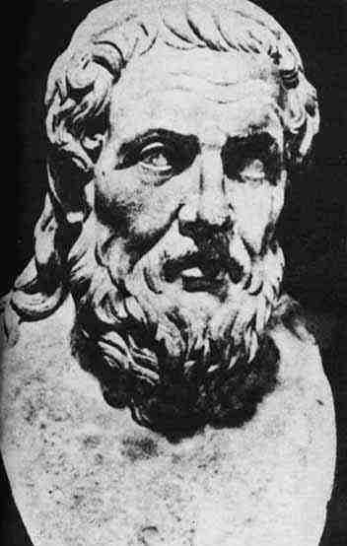
Archimedes (c. 287 BC – c. 212 BC)
Euclid Archimedes √ Pythagoras

Slide 12
Was Archimedes Italian?!
That depends
Of course, most people think of him as Greek
He lived in Syracuse, a colony of Magna Graecia
But Syracuse is in Sicily!
Thus, technically, he was Italian

Slide 13
Archimedes II
Archimedes is generally considered to be the greatest mathematician of antiquity
He discovered the laws of buoyancy (Remember Eureka!)
He calculated the value of π to within an accuracy of three decimal places!
He essentially used the methods of calculus some 2 millennia before Sir Isaac Newton

Slide 14
Archimedes III
He wrote the classic tome “On the Sphere and Cylinder” in which he proved the remarkable result:
If a sphere is circumscribed by a cylinder, then, in both volume and surface area, the values for the cylinder are precisely 3/2 times those of the sphere.

Slide 15
Archimedes IV
r
2r =h

Slide 16
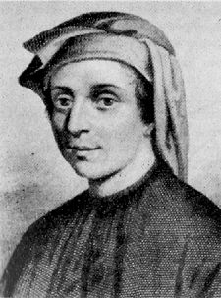
Leonardo of Pisa (c. 1170 – c.1250)

Slide 17
Leonardo of Pisa II
Better known as Fibonacci, he introduced the Hindu-Arabic numeral system to Europe
In his book, “Liber Abaci” (Book of Calculations), he introduced much of the mathematics of antiquity that had been preserved from the Golden Age of Greece and enhanced and advanced by the Arabs and the Indians

Slide 18
Fibonacci Numbers
A problem given in Liber Abaci goes as follows:
Begin with a pair of rabbits, 1 male & 1 female
Rabbits reach sexual maturity after 1 month
After reaching maturity, a female rabbit gives birth to a pair (1 male & 1 female) every month
Rabbits never die
How many pairs of rabbits are there after n months?

Slide 19
Fibonacci Numbers II
The answer to this problem is given by the famous sequence called the Fibonacci numbers:
F₁ = 1 F₂ = 1 F₃ = 2 F₄ = 3 ….
F_{n} = F_{n-1} + F_{n-2}

Slide 20
Fibonacci Numbers III
The Fibonacci numbers have the marvelous property that the ratio of sequential numbers in this sequence approach the Golden Ratio, Φ, in the limit
That is:

Slide 21
The Golden Ratio, Φ
The Golden Ratio was studied by the Greeks
It is defined as follows:
Take a length and divide it into two unequal pieces in such a way that the entire length is to the longer (A) as the longer is to the smaller (B). The common ratio is Φ
Thus

Slide 22
A Line Segment in Golden Ratio

Slide 23
The Golden Quadratic
Cross multiplication yields:

Slide 24
The Golden Quadratic II
Dividing the equation through by B² , setting Φ equal to the quotient A/B and manipulating this equation shows that Φ satisfies the quadratic equation:

Slide 25
The Golden Quadratic III
Applying the quadratic formula to this simple equation and taking Φ to be the positive solution yields:

Slide 26
Two Important Properties of Φ
1/ Φ = Φ - 1
Φ² = Φ +1
These both follow directly from our quadratic equation:

Slide 27
Φ Is an Infinite Square Root

Slide 28
Φ as a Continued Fraction

Slide 29
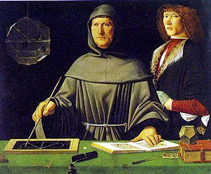
Luca Pacioli (1446 – 1517)

Slide 30
Pacioli
Franciscan Friar
Held the first chair at the University of Perugia
Incidentally, the oldest university in Europe is the University of Bologna (founded 1088)
Taught Mathematics to Leonardo da Vinci
Father of Accounting

Slide 31
Pacioli II
Wrote a treatise on Mathematics and Magic
Wrote De Divina Proportione (The Divine Proportion) about the Golden Ratio
Worked at the problem of finding roots of polynomials
The roots of a quadratic are found using the quadratic formula (discovered by the Arabs)
Pacioli worked at extending this to cubic polynomials

Slide 32
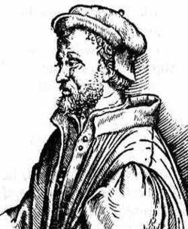
Girolamo Cardano (1501 – 1576)

Slide 33
Cardano II
Cardano succeeded where Pacioli has failed in finding a general method to finding the roots of a general cubic
He, together with his student, Ferrari, extended this to a method for finding the roots of a general quartic (published in his book Ars Magna)

Slide 34
Cardano III
While Cardano was a superb mathematician, he was quite a colorful character and he led a soap opera of a life
He was the illegitimate son of a mathematically gifted lawyer
He kept himself solvent by gambling and playing chess for money
His eldest son was executed for poisoning his unfaithful wife

Slide 35
Cardano IV
Even his mathematical life was filled with drama
He learned the secret of solving a particular case of the cubic equation from another gifted mathematician, Niccolo Fontana (known as “Tartaglia” --- the stutterer)
Cardano took an oath never to reveal the secret but published the method, anyway
This led to a decades-long feud between Cardano and Fontana

Slide 36
Rafael Bombelli (1526 – 1572)
Bombelli published a major work entitled Algebra
In it, he extended the number field to include square roots (along with methods for computing them) and cube roots
More important, he gave a description of i, the square root of -1
He established the foundations upon which the complex numbers are based

Slide 37
Giovanni Saccheri (1667- 1733)
Saccheri laid the ground-work for the establishment of non-Euclidean Geometry
He wrote Euclid Freed of Every Flaw
He is most noted for the Saccheri – Legendre Theorem which states that the sum of the angles of every triangle must be at most 180 degrees!
This led to the establishment of Hyperbolic Geometry

Slide 38
Eugenio Beltrami (1835-1900)
Was the first to prove the consistency of non-Euclidean Geometry
Produced a model of Hyperbolic Geometry on a surface of constant negative curvature (a pseudo sphere)
Produced another model of Hyperbolic Geometry inside a unit disk (the Beltrami – Klein Model)
Beltrami also worked in the field of Differential Geometry --- a branch of Geometry that uses calculus

Slide 39
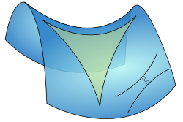
A Triangle in Differential Geometry

Slide 40
Guido Fubini (1879 – 1943)
Most famous for the theorem that bears his name, Fubini’s Theorem
This states that under certain conditions, a double integral can be computed as an iterated integral, thus allowing for change of order of integration

Slide 41
Mathematics: The Italian Connection
This is just a short, select list of major Italian mathematicians and their contributions to the discipline
Of course, one could go on and on
I do hope that I have succeeded in adding Mathematics to the list of things that you think of when you think of Italy
Thank you

